Slide 1
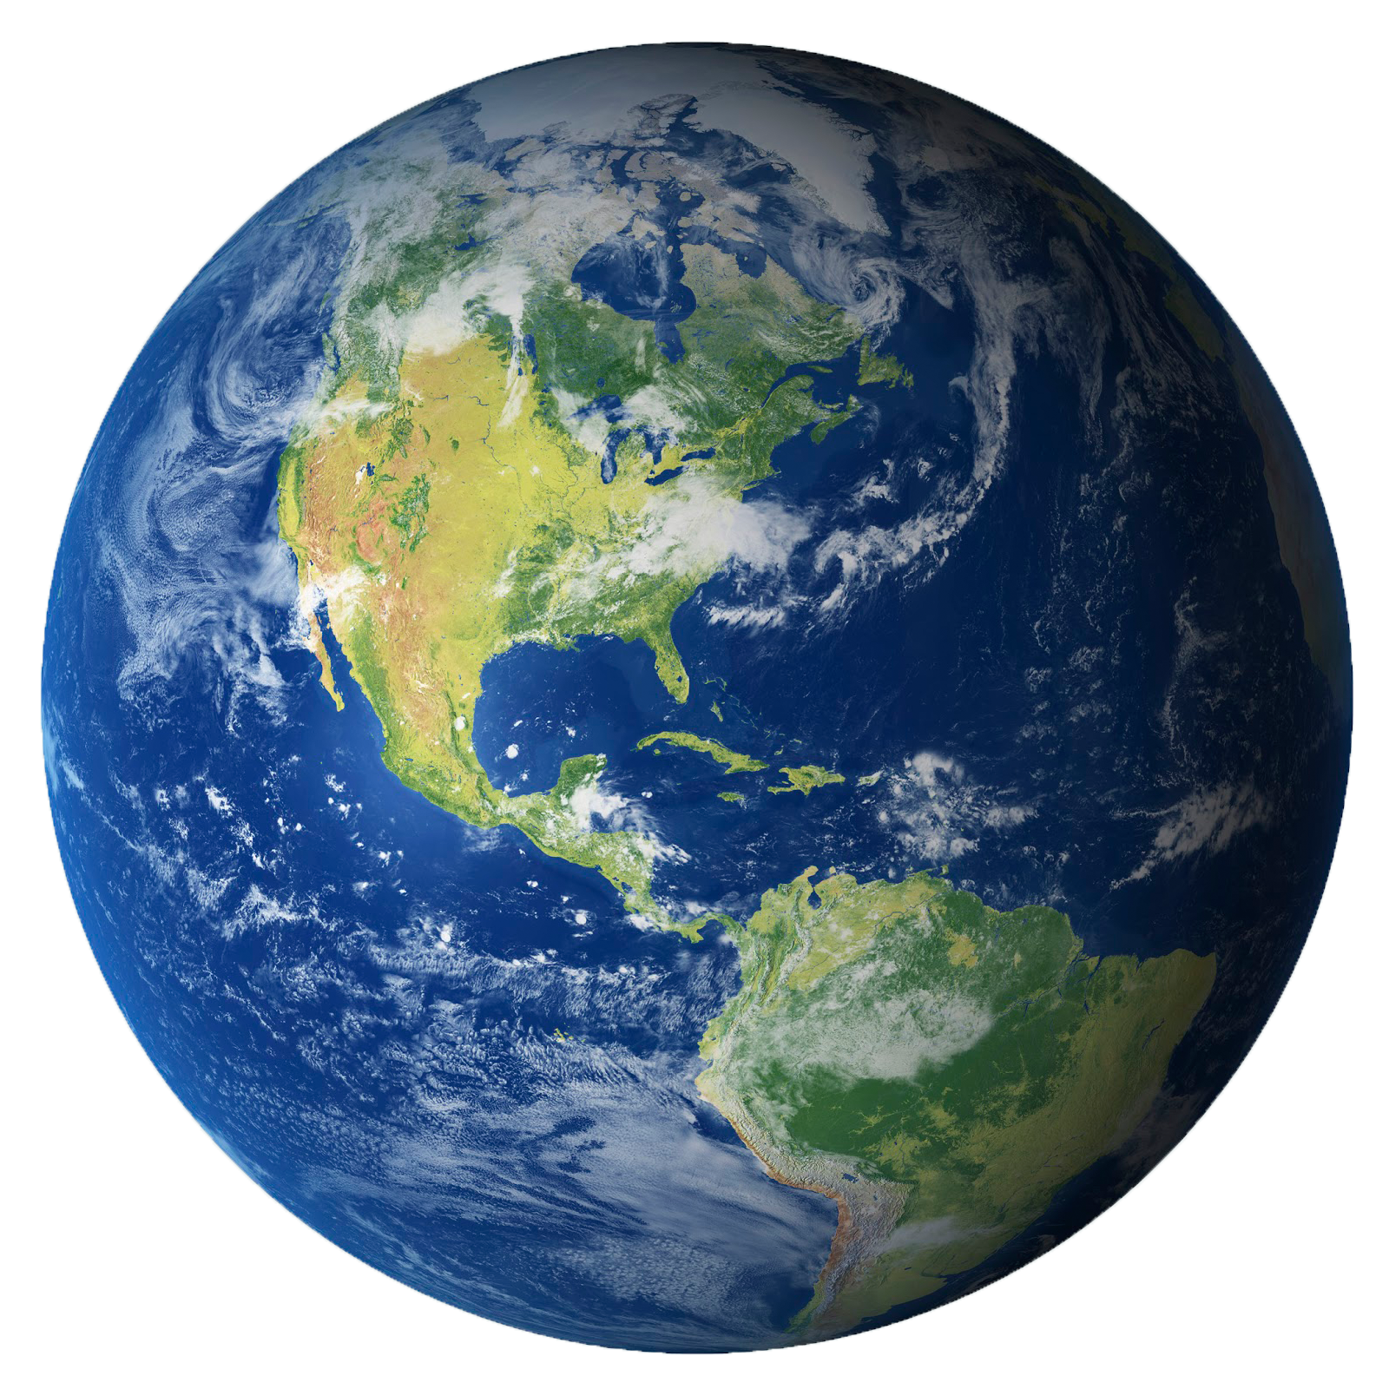
nnecting
C
~Beyond~
B
undaries

Slide 2
2nd page picture of earth

